Slide 1

Amoun Language Schools School Management System (LMS)
Karim Ehab, Youssif Assem, Mohamed Moataz & Philip George
Supervised by: Dr. Essam Eliwa, Dr. Yomna Ibrahim Supervising Assistant: Eng. Nada Ayman
<number>

Slide 2
Agenda:
SOFTWARE ENGINEERING (SE305)
Introduction
Problem Statement
System Overview
Use Case Diagram
Functional Requirements
Non-Functional Requirements
Database Diagram
Class Diagram
Prototype
Live Demo
HUMAN COMPUTER INTERACTION (CSC341)
PACT Analysis
HTA
<number>

Slide 3
FIRST: SOFTWARE ENGINEERING

Slide 4
Introduction
<number>

Slide 5
Introduction:
When coronavirus conquered Earth at the end of 2019, all entities had gone online like: private and public companies, schools, universites, …etc.
No doubt, some education authorities in Egypt started e-learning especially universites. So, we decided to create not only learning system but also, a management one.
We believe that LMS in this pandemic time became something necessary all over the world.
<number>

Slide 6
Problem Statement
<number>

Slide 7
Problem Statement:
Online and e-learning systems for schools are a bit neglected. So when the pandemic hit our country. The online system was needed more than ever. It was not provided the way that the student needed it to be for him/her to benefit fully from it.
<number>

Slide 8
System Overview
<number>

Slide 9
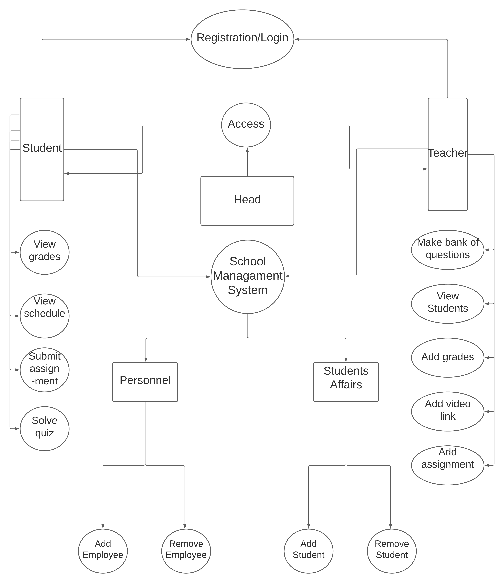
<number>

Slide 10
Use Case:
<number>

Slide 11
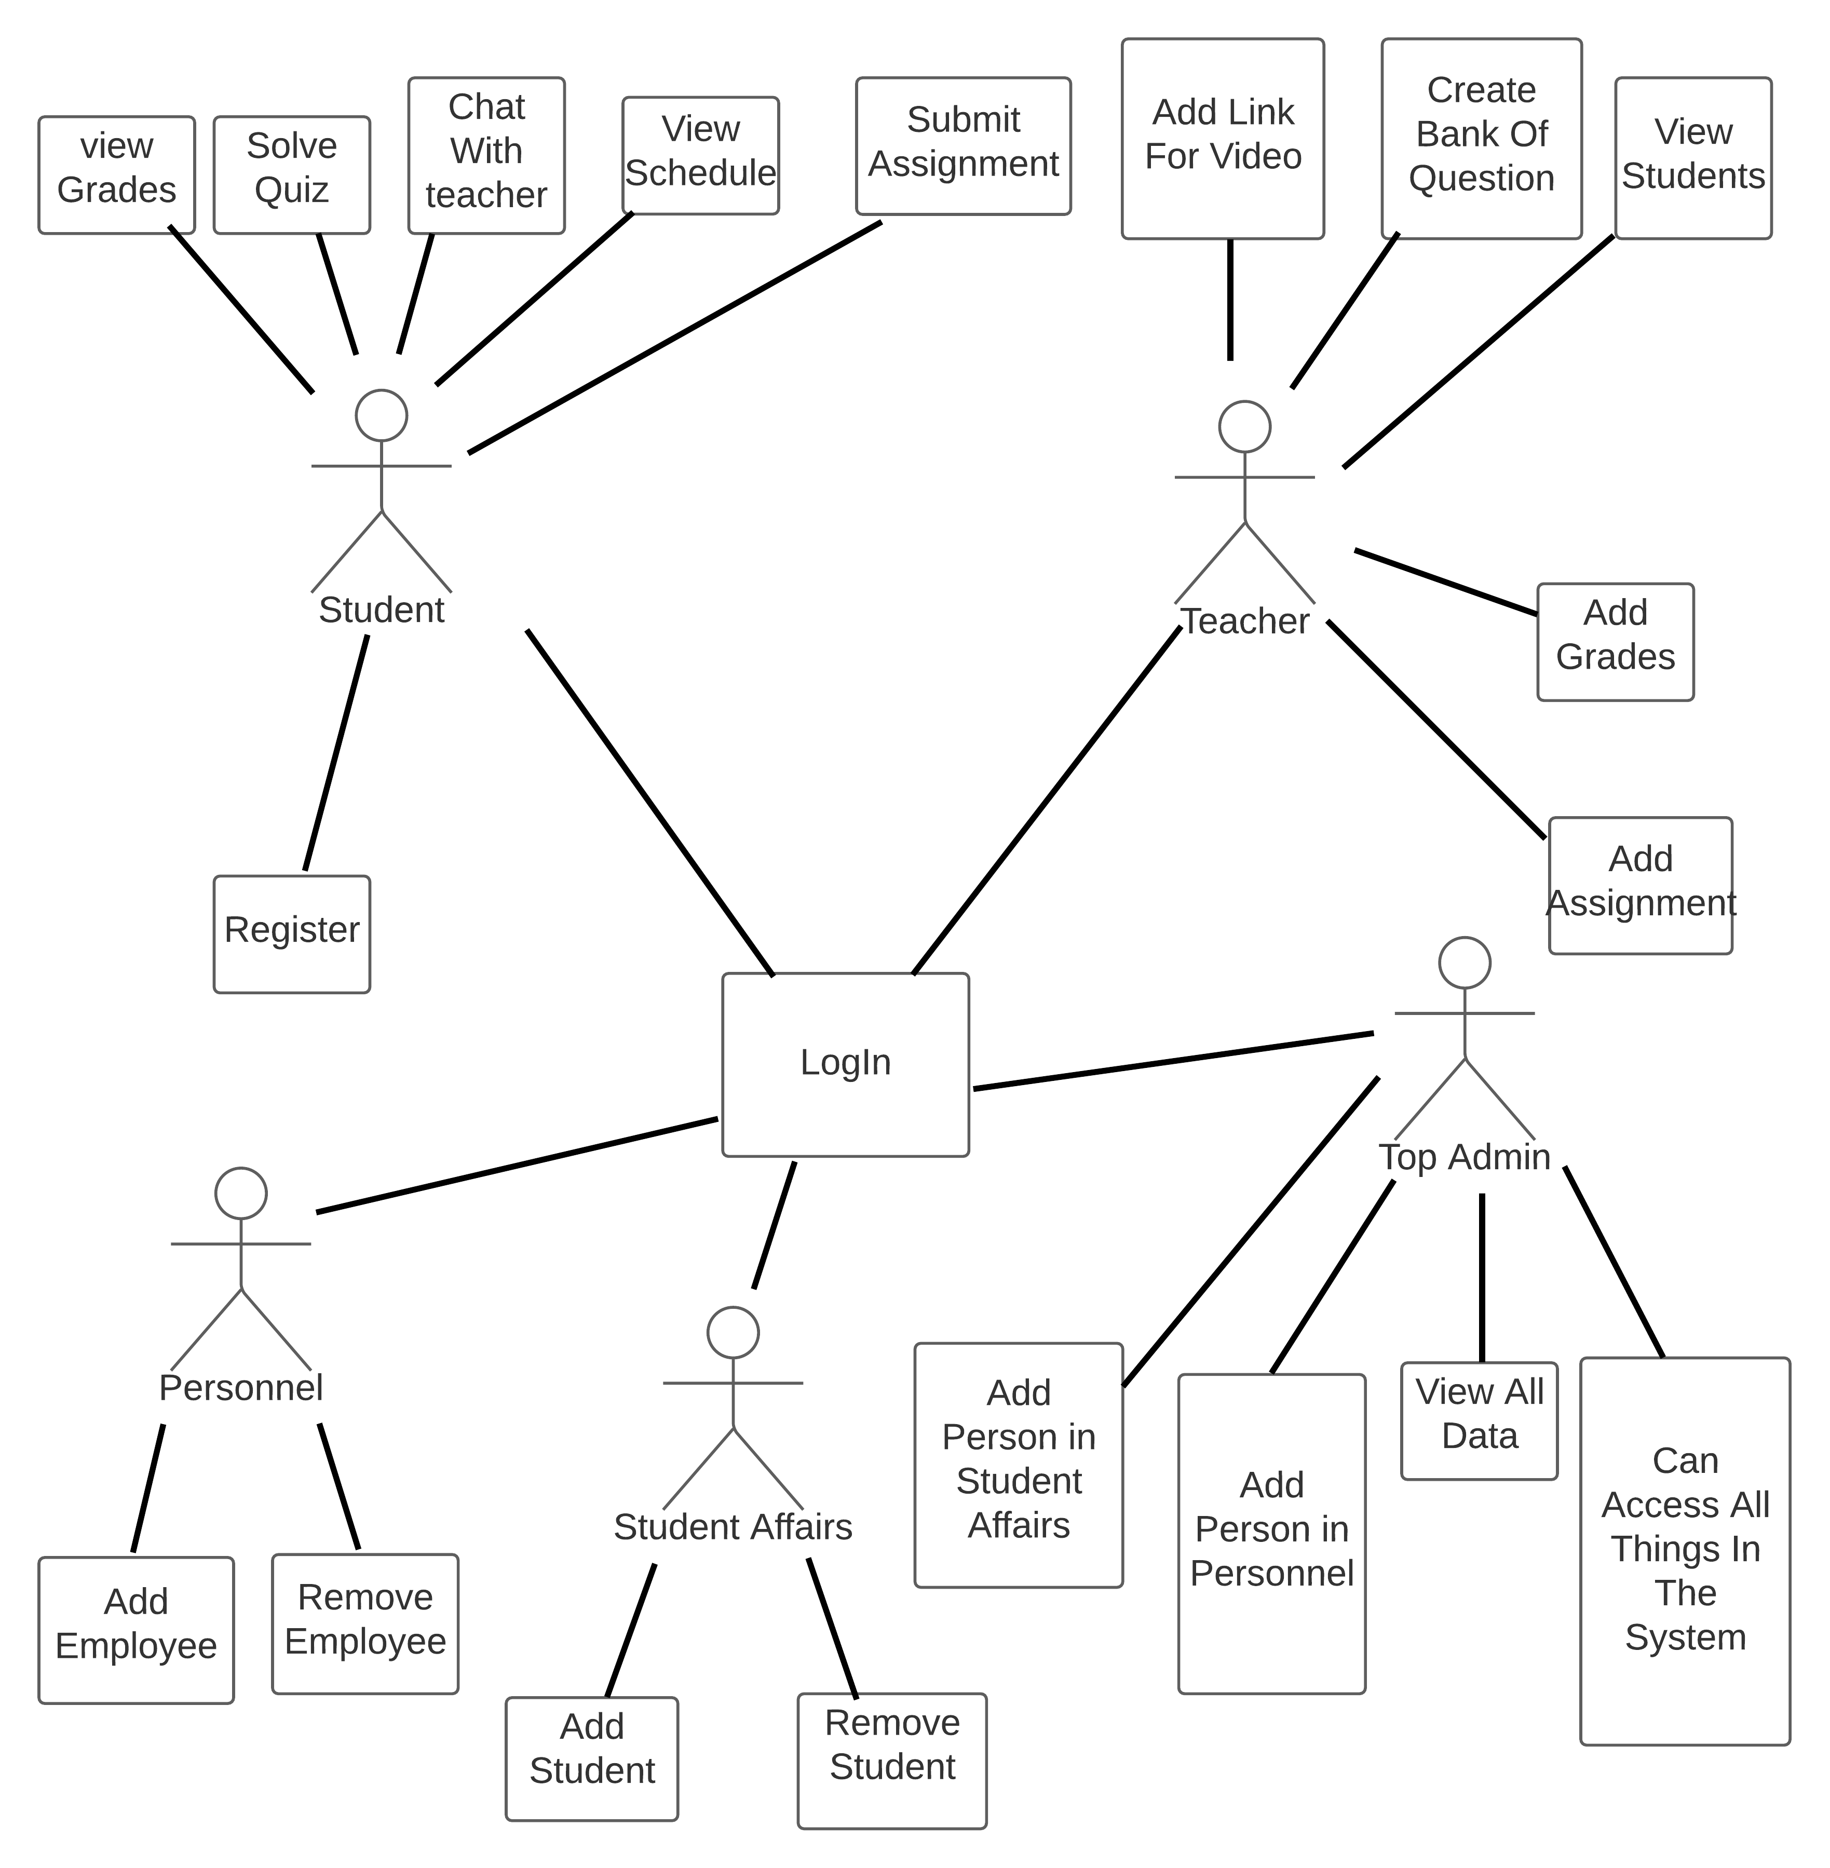
Use Case Diagram:
<number>

Slide 12
Functional Requirements
<number>

Slide 13
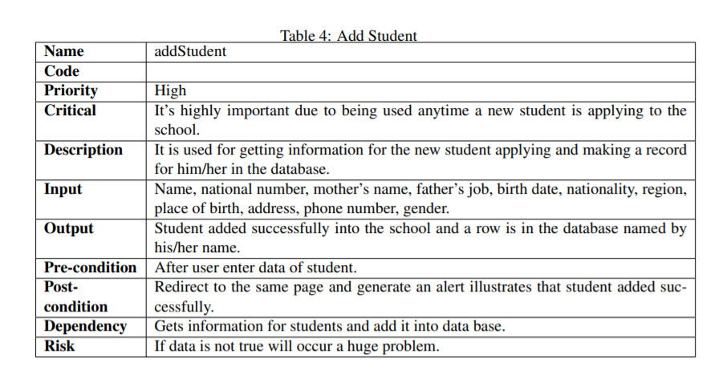
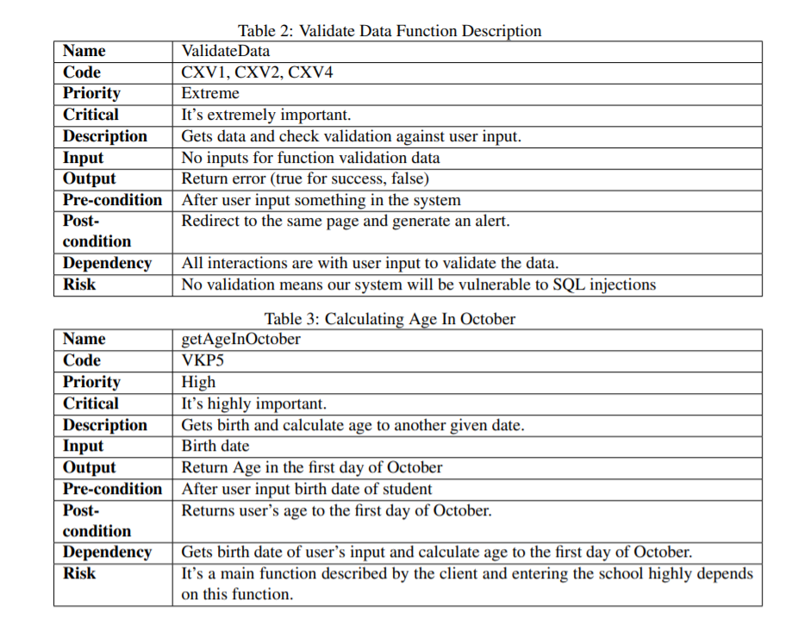
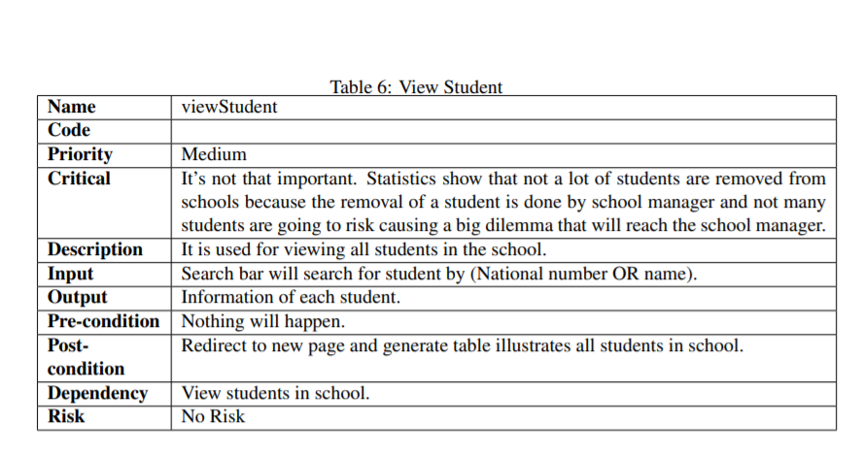
Functional Requirements:
<number>

Slide 14
Non- Functional Requirements
<number>

Slide 15






Non-Functional Requirements:
Security
Accessibilty
Availability
Performance
Usability
Hashing
Encryption
MVC
Different Platforms
Offer client’s needs
Ease of use and understanding
Efficient as it should be
<number>

Slide 16
Database Diagram
<number>

Slide 17
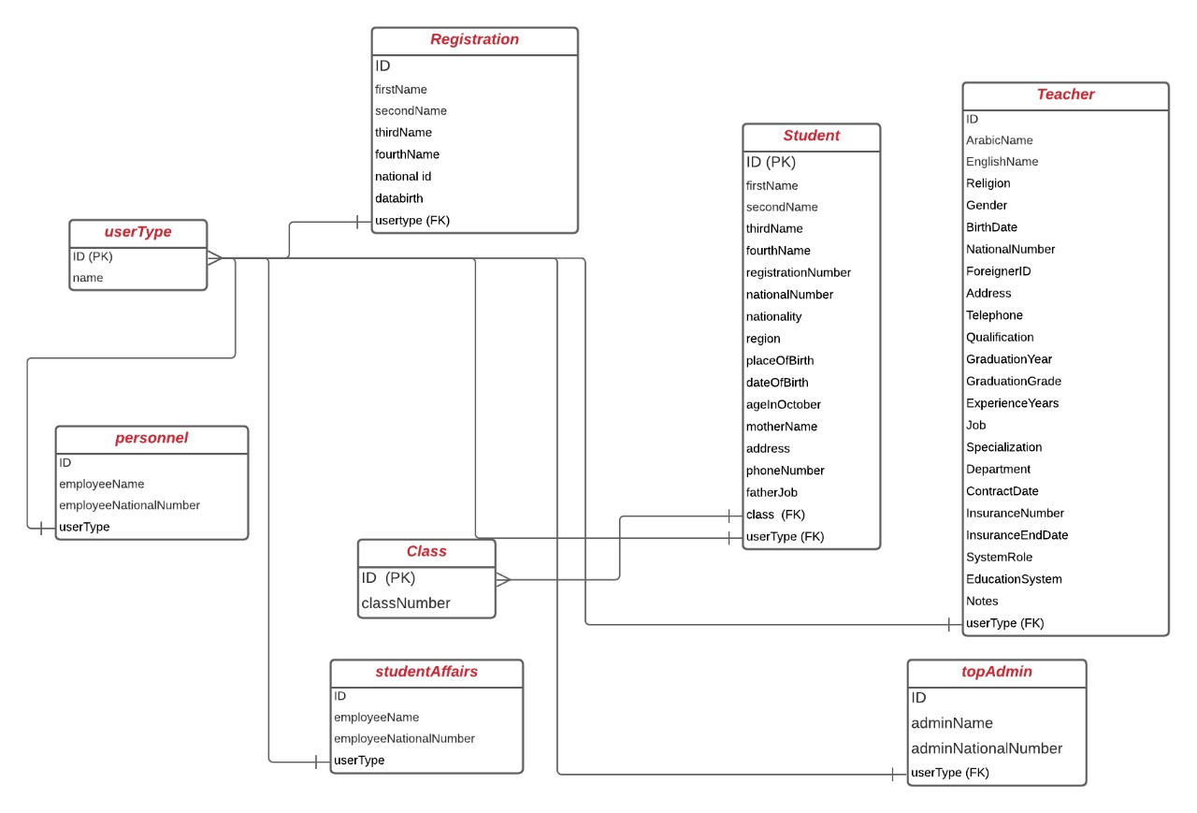
Database Diagram:
<number>

Slide 18
Class Diagram
<number>

Slide 19
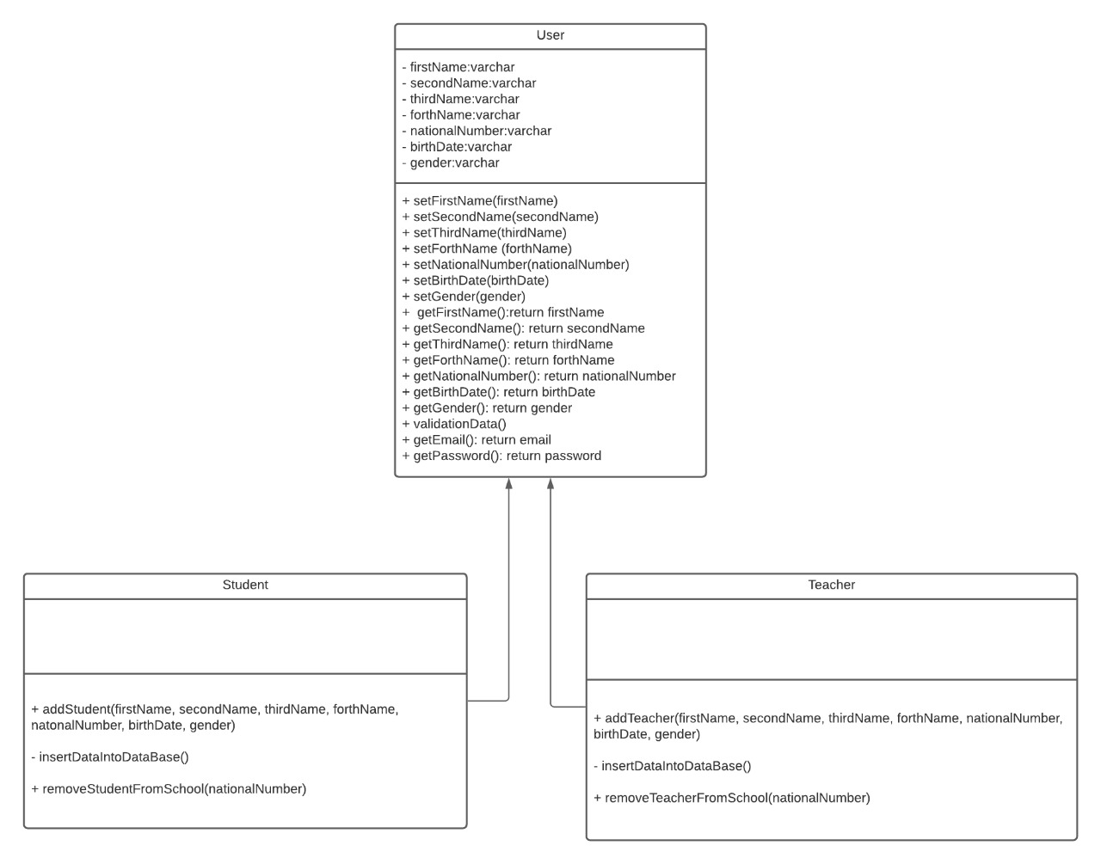
Class Diagram:
<number>

Slide 20
Wireframes and Prototypes
<number>

Slide 21
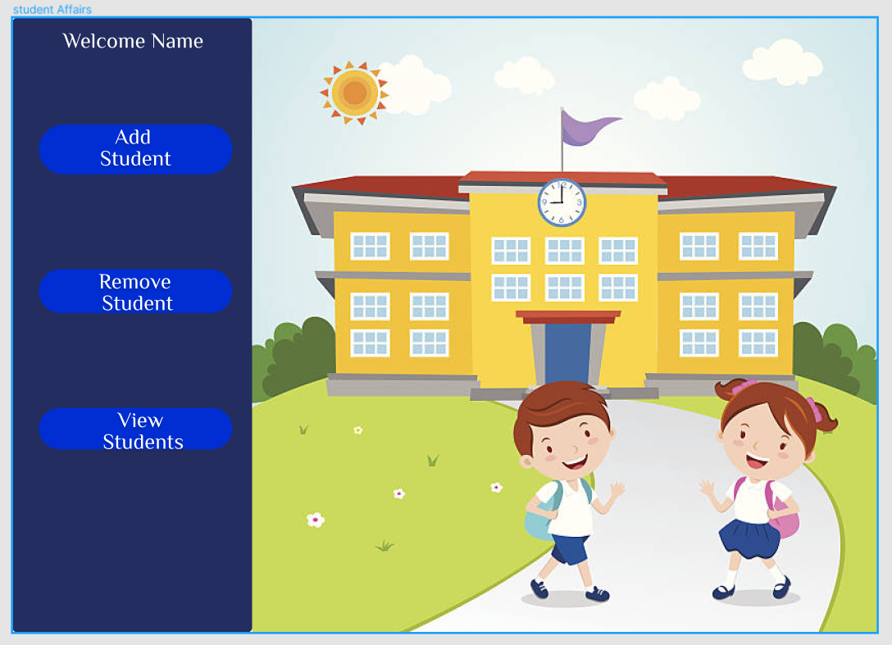
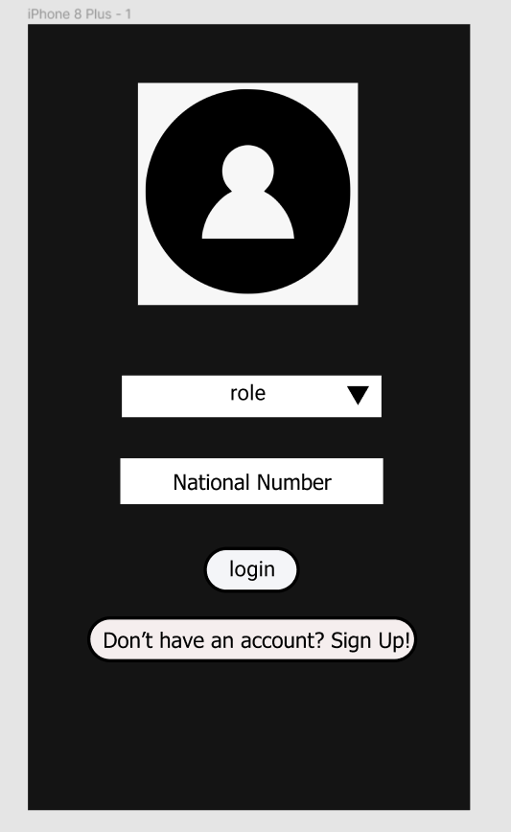
Prototype(1/2):
We gave samples on different platforms.
<number>

Slide 22
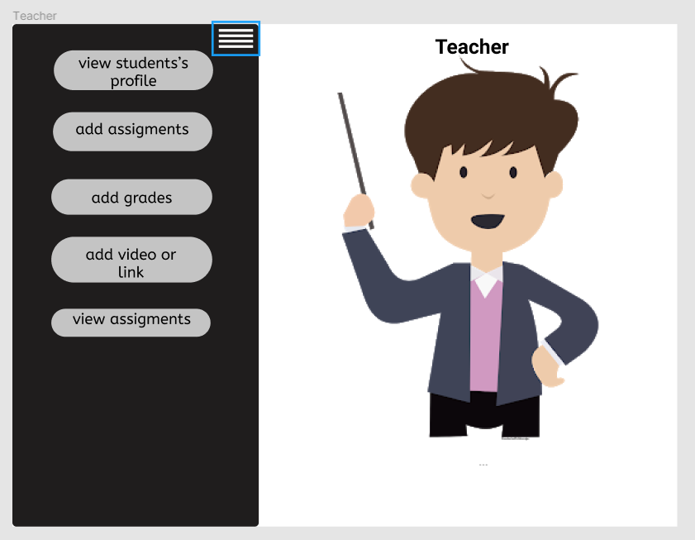
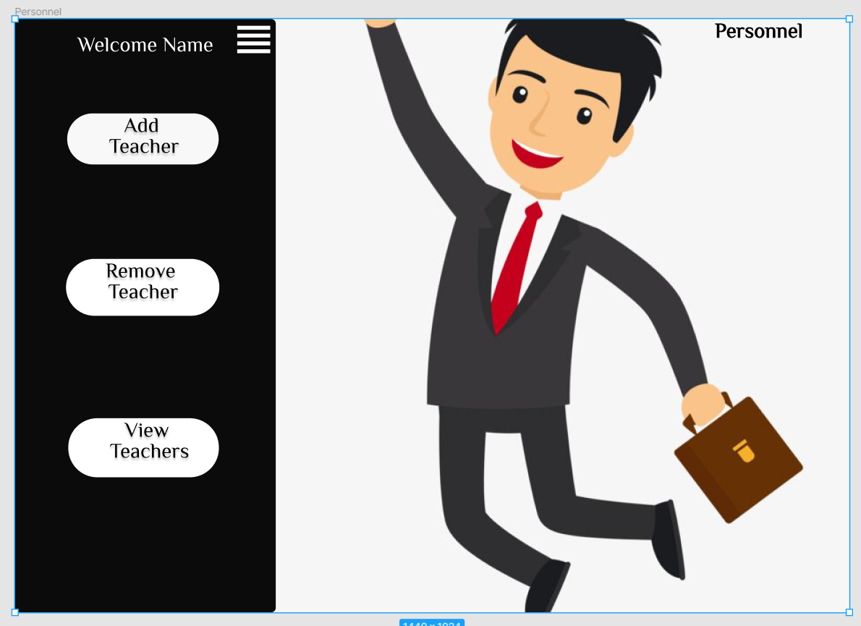
Prototype(2/2):

Slide 23
Live Demo
<number>

Slide 24
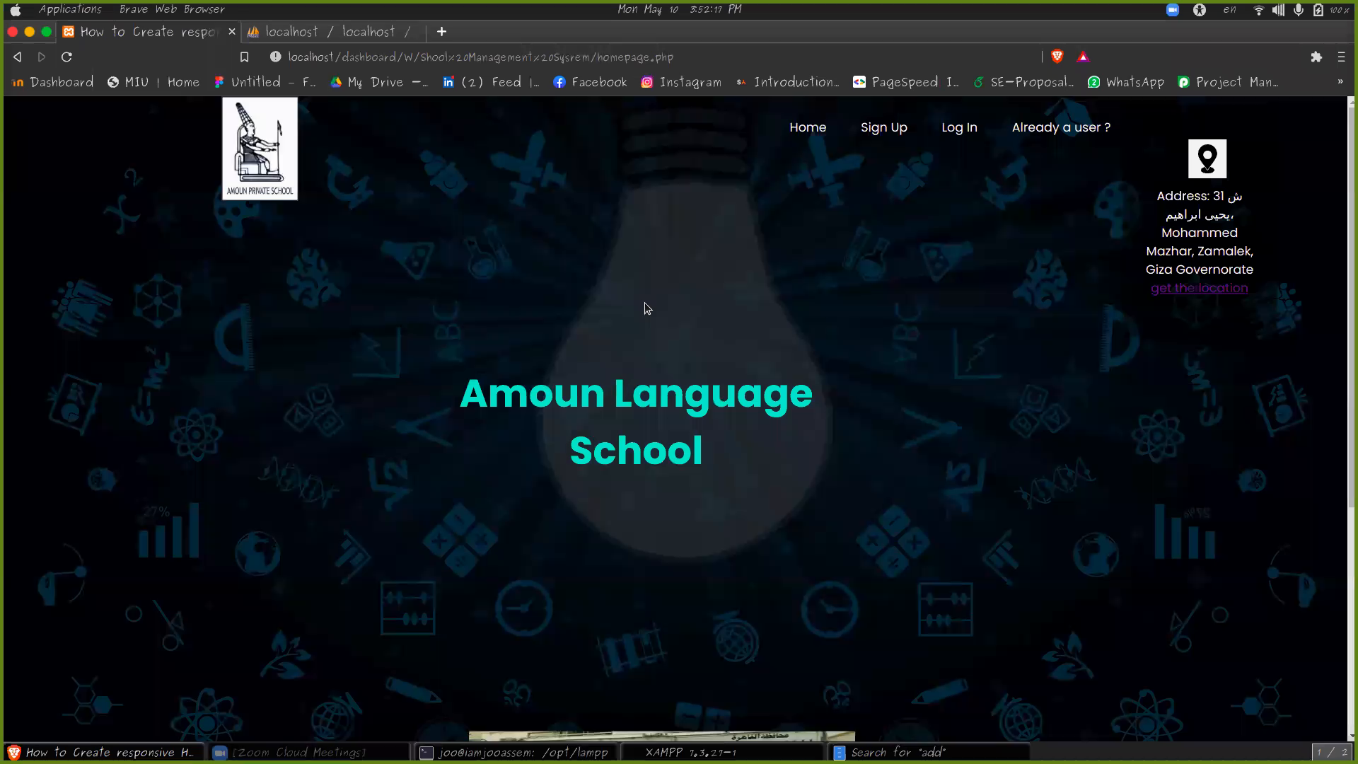

Slide 25
SECOND: HCI

Slide 26
PACT ANALYSIS

Slide 27
People (P)
n Early 2020, the world suffered from some dilemmas due to coronavirus. In addition, everything had gone online. So, students need this online application to solve quizzes, and to be monitored more by teachers. Teachers need this application to make quizzes from a back of questions for students to test their work and monitor them. Besides to student affairs’ and personnel’s manager.

Slide 28
Activities (A)
Teacher and student can register and log in into the system. Besides, teacher can insert a bank of questions and choose random questions from it. Teacher can add grades for the student and view them in his/her class. Student can answer these questions and can chat with his/her teacher, Besides, student can view his/her grades and schedule.

Slide 29
Context (C)
The web application can be used in multiple places. It is mainly used online at home and in school to register.

Slide 30
Technologies (T)
Different platforms with different operating systems like:
Web (PC, Laptops, through browsers)
Android
IOS devices

Slide 31
HTA

Slide 32
1- Open the browser and access Amoun web application.
2- If you are a new student you will register as a new student.
3- Sign in as a student, teacher, student affairs, personnel, top admin.
4- From signing in you will have access to the system depending on the role you have in school. (Sign In step)
4.1- If teacher
4.1.1- Add quizzes
4.1.2- Create bank of questions
4.1.3- View students
4.1.4– Add video link
4.1.5- Add grade for student
4.1.6- Contact student (answer questions)

Slide 33
4.2- If Student
4.2.1- Answering Questions
4.2.2- View Grades
4.2.3- View Courses
4.2.4- Contact the teacher (send message to teacher)
4.2.5- View Schedule
4.3- If Student Affairs
4.3.1- Add student
4.3.2- Remove student
4.3.3- View students

Slide 34
4.4- If Personnel
4.4.1- Add teacher
4.4.2- Remove teacher
4.4.3- View teachers
4.5- If Top
4.5.1- View, edit, and access anything in the system.
5- Sign Out
6- Close Application

Slide 35
THANK YOU!
Any Questions ?
<number>

